Slide 1

Python for Beginners with applications Lesson 8: Introduction to Pandas library
Write code from scratch in a clear & concise way, with a complete basic course.
From beginners to intermediate.
Abdesselam Filali 2025-07-01 17h00 Algiers time

Slide 2

3. Introduction to Pandas library

Slide 3

What is Pandas? pandas is a fast, powerful, flexible and easy to use open source data analysis and manipulation tool, built on top of the Python programming language. Why use pandas? Pandas allows us to analyze big data and make conclusions based on statistical theories. Pandas can clean messy data sets and make them readable and relevant. Relevant data is very important in data science.
Exceptions and error handling
Pandas Library
https://www.w3schools.com/python/pandas/default.asp
https://pandas.pydata.org/

Slide 4
What Can Pandas Do? Pandas gives you answers about the data. Like: Is there a correlation between two or more columns? What is average value? Max value? Min value? Pandas are also able to delete rows that are not relevant, or contains wrong values, like empty or NULL values. This is called cleaning the data.
Exceptions and error handling
Pandas Library
https://www.w3schools.com/python/pandas/default.asp
https://pandas.pydata.org/

Slide 5
installation pip install pandas importing import pandas as pd
Exceptions and error handling
Pandas Library
https://www.w3schools.com/python/pandas/default.asp
https://pandas.pydata.org/

Slide 6
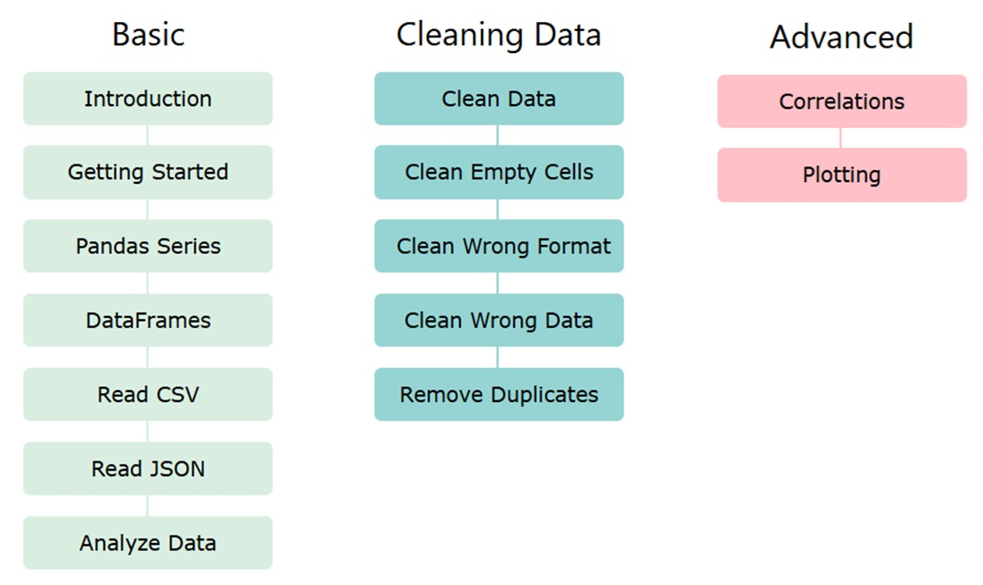
Exceptions and error handling
Pandas Library
https://www.w3schools.com/python/pandas/default.asp
https://pandas.pydata.org/

Slide 7
Import pandas import pandas as pd example: import pandas mydataset = { 'cars': ["BMW", "Volvo", "Ford"], 'passings': [3, 7, 2] } myvar = pandas.DataFrame(mydataset) print(myvar) pandas as pd import pandas as pd Checking pandas version print(pd.__version__)
Exceptions and error handling
Pandas Library
https://www.w3schools.com/python/pandas/default.asp
https://pandas.pydata.org/

